Slide 1
RTOS
Semaphores

Slide 2
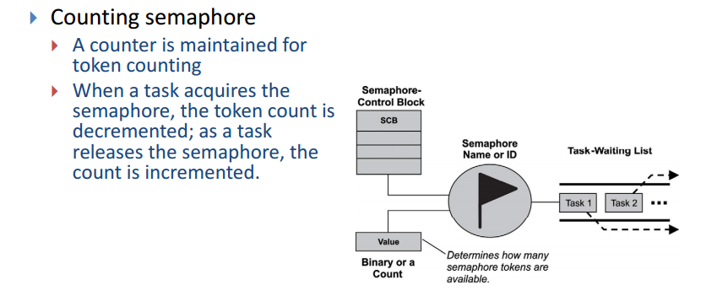

Slide 3
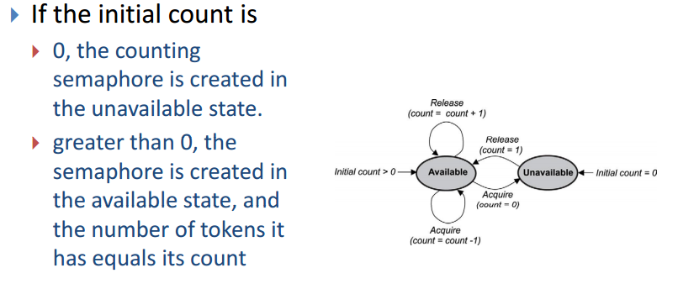

Slide 4
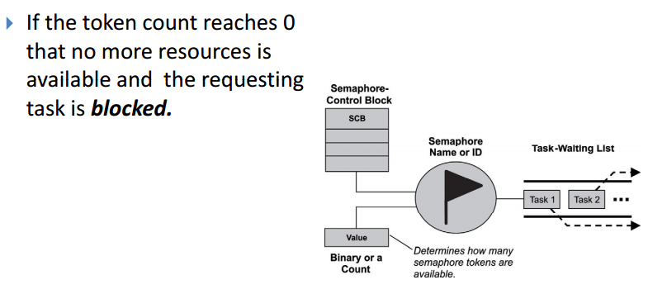

Slide 5
Managing resources using counting semaphores
Resources can also be controlled with counting semaphores.
In this case, the value of the counting semaphore represents how many of the resources are available for use.
A common example is that of a ring buffer. A ring buffer has space for m elements, and elements are added to and removed from it by different parts of an application.

Slide 6
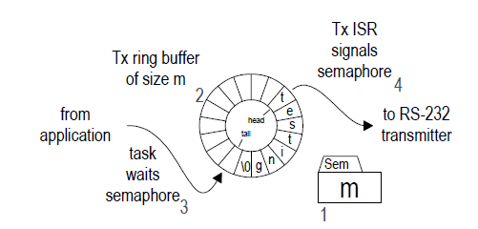
Example – Serial Communication
Following figure shows a scheme to transmit character strings via RS-232 using a counting semaphore to control access to a ring buffer.

Slide 7
a counting semaphore is initialized to m [1] to represent the number of spaces available in the empty ring buffer [2]

Slide 8
The ring buffer is filled at its tail by the task [3] and emptied from its head by the ISR [4].

Slide 9
Before adding a character to the buffer the task must wait the semaphore. If it is blocked, it means that the buffer is full and cannot accept any more characters.

Slide 10
If the buffer is not full, the semaphore is decremented, the task places the character at the tail of the buffer and increments the tail pointer.

Slide 11
Once there are characters in the buffer, for each character the Tx ISR will remove it from the buffer, transmit it and increment the semaphore by signaling it.

Slide 12
